Slide 1
P
PRONTO
DEMO 4
Team: Agile Architects
Client: AWS

Slide 2
System Overview
System Overview
Multi-purpose
Add institution information
Multi-purpose application that will be used by universities, lecturers, and students.
Institutions will be able to upload their university lecture schedules, campus maps and files for students to view.
Create timetable
Single Consolidated Application
Students will be able to create, edit and view custom timetables.
This application aims to help students organise their schedules and also bring together the features of reminders, campus navigation, and lecture timetables into a single application.
Send reminders
Lecturers will be able to send reminders for important events like exams and project due dates, as well as notify them of assignment extensions.

Slide 3
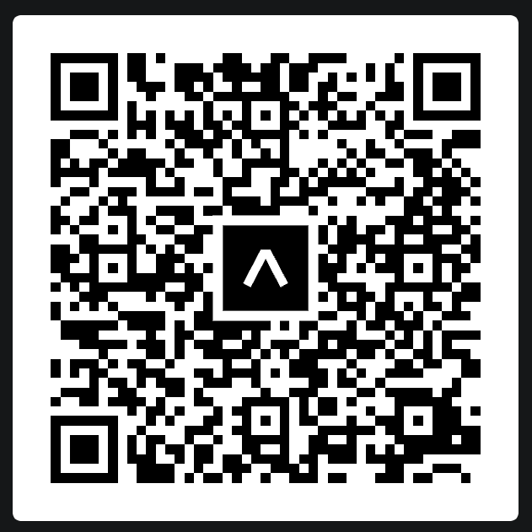
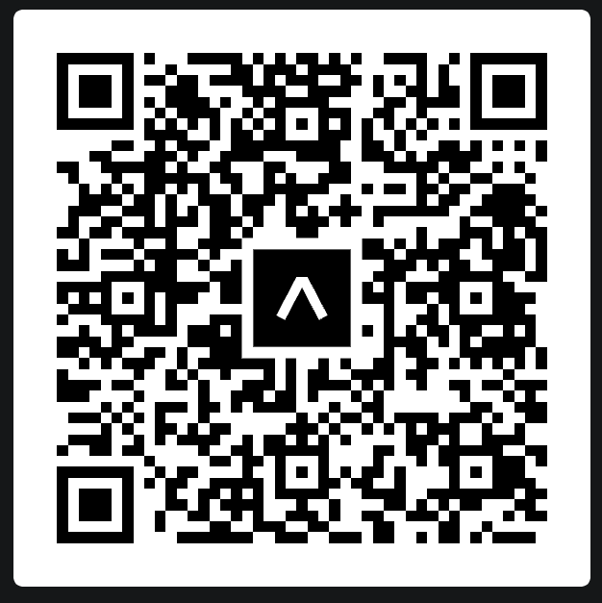
Student Mobile App
Web App for Lecturers and Institutions
Download Expo Go
Visit the link:
Download the ExpoGo application on Android or IOS
https://www.prontotimetable.co.za
Scan this QR code
IOS
Android

Slide 4

Extra Features
Convenient, easy to use campus navigation
Choose from any of your modules posted venues
Show/hide step by step directions
Download created timetable
Obtain a pdf version of your custom timetable for offline viewing
Fourth Role- Super Admin
Power to process Institution applications, create an institution,
and add or remove users.
Security: Highly secure role-based access and system as a whole
Lecturers can see stats of how many students successfully received notifications
Highly useable interface

Slide 5
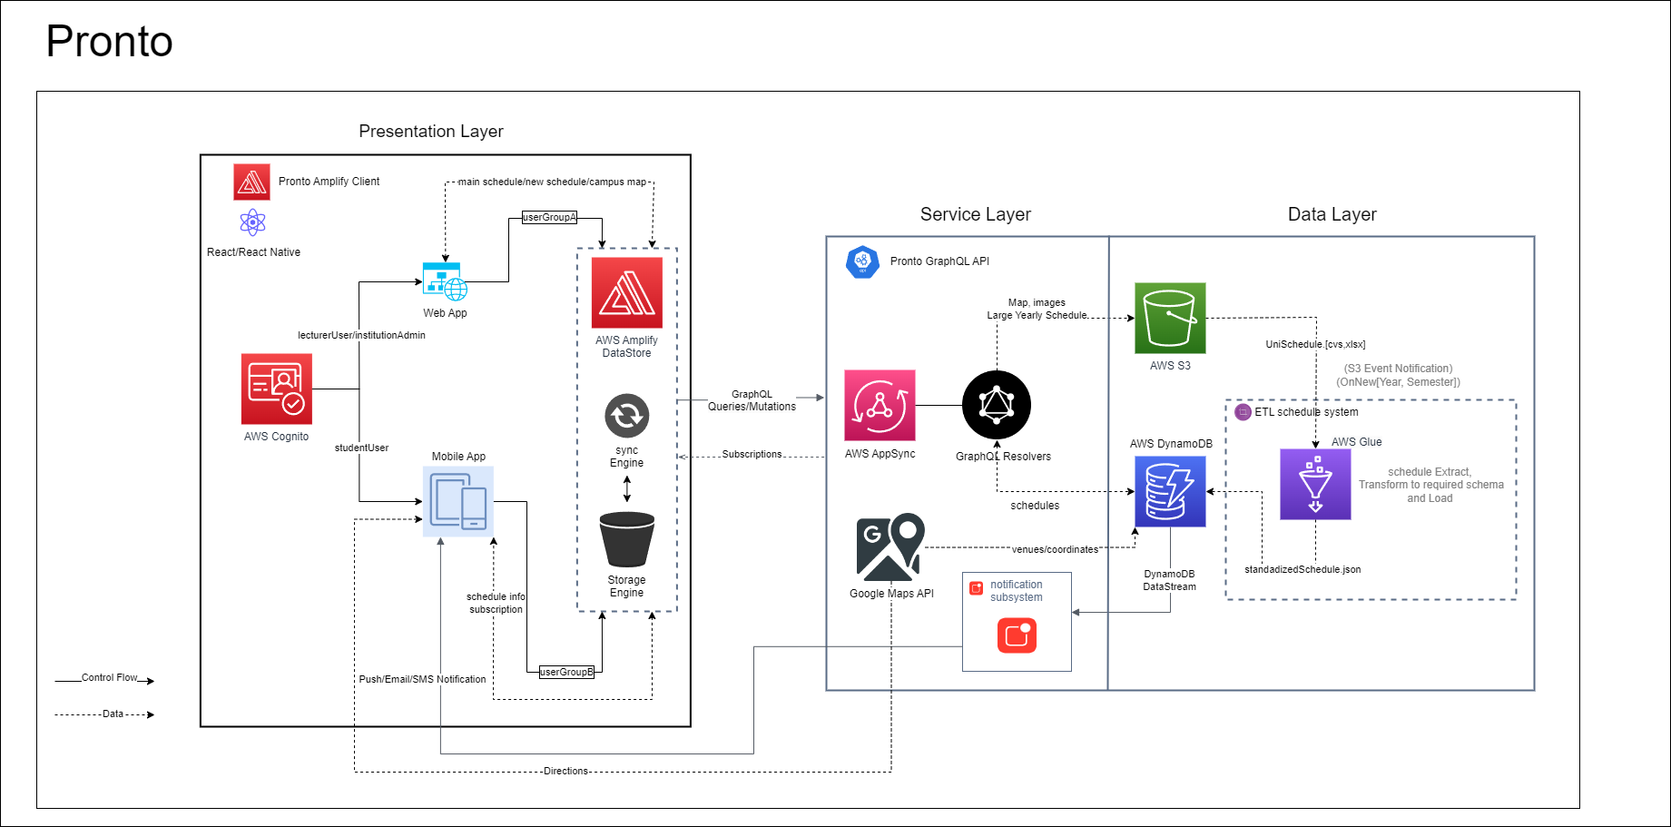
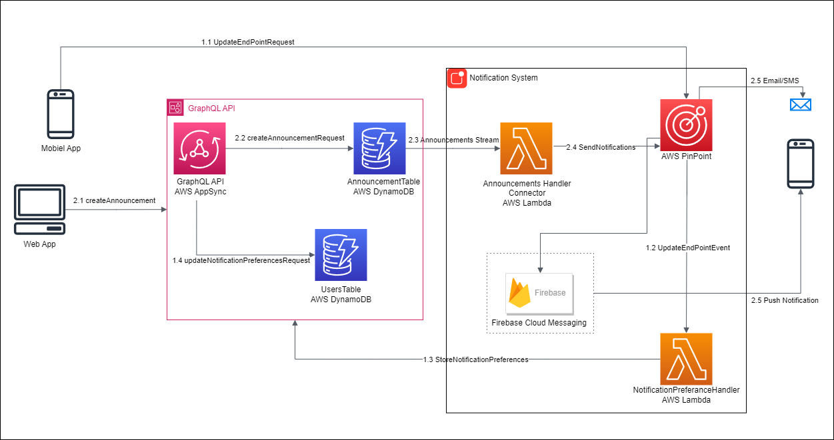
Architectural design
Architecture Patterns used:
Three Tier Architecture
Component Based Architecture
Serverless Computing Architecture
Service Oriented Architecture

Slide 6

Quality Assurance
Security
Encryption in transit (HTTPS) and at rest
Role Based Access with protected routes
Injection and XSS prevention
JSON Web Tokens
Maintainability
Component based architecture
Thorough unit tests and code coverage
Uniform variable naming conventions
Useability
Feedback from Clients
Feedback from useability tests carried out on peers

Slide 7
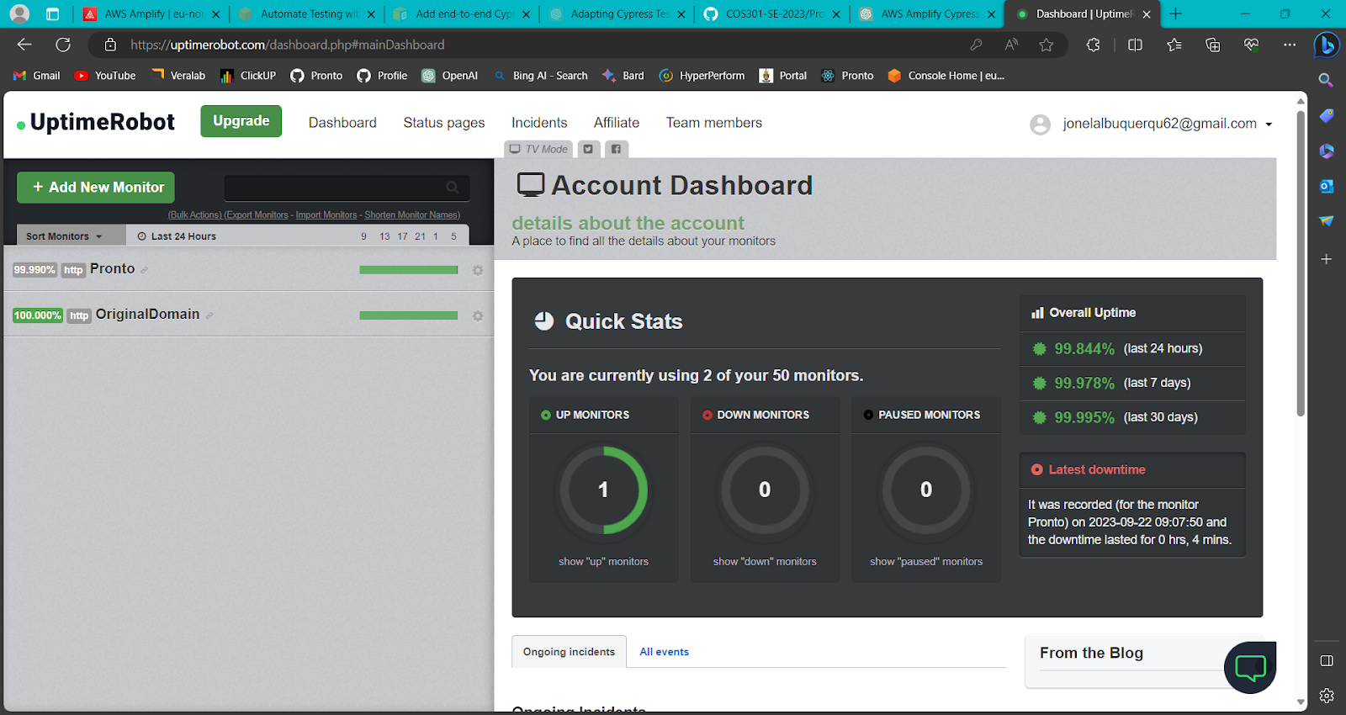
Quality Assurance
Performance and Availability
Used lighthouse performance testing from google
Uptime measured using uptime robot, well over 99%

Slide 8
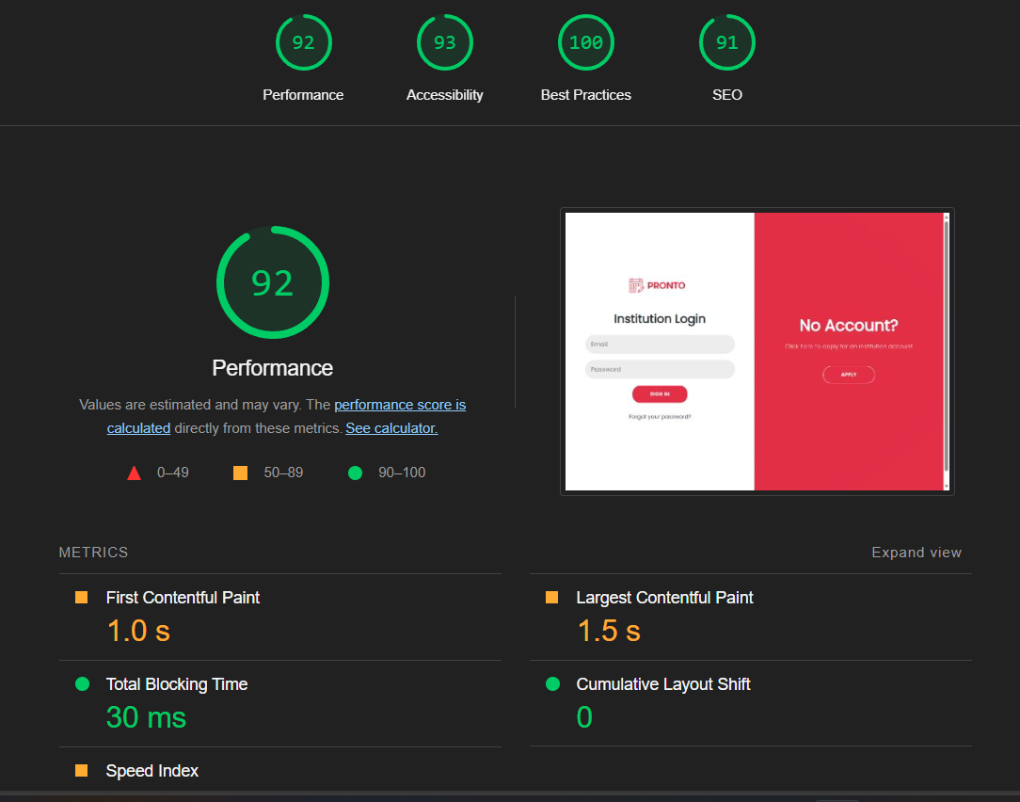
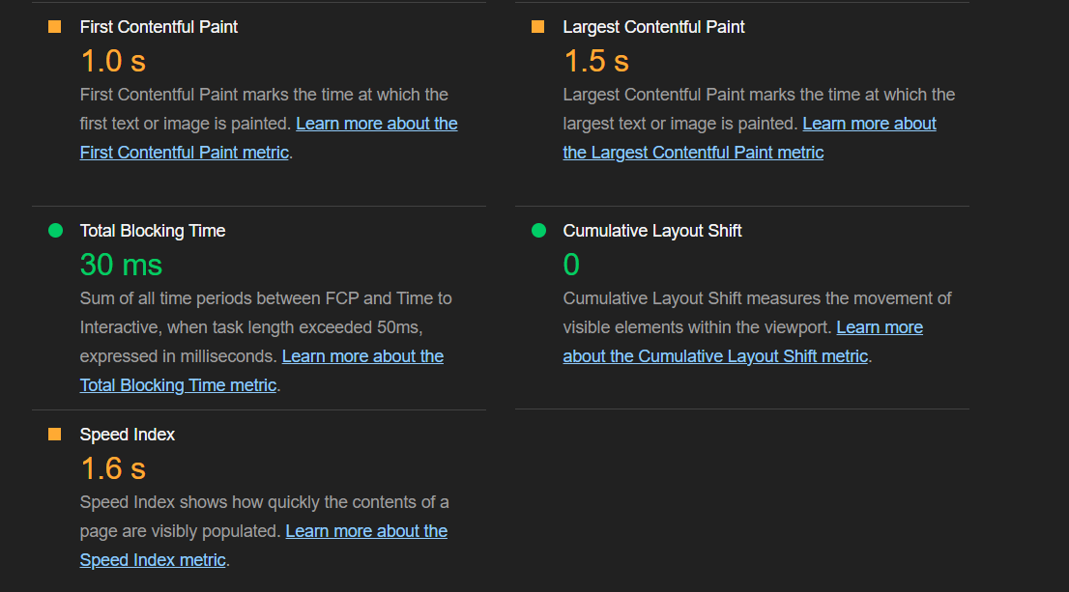
Quality Assurance
Performance and Availability
Used lighthouse performance testing from google
Uptime measured using uptime robot, well over 99%

Slide 9
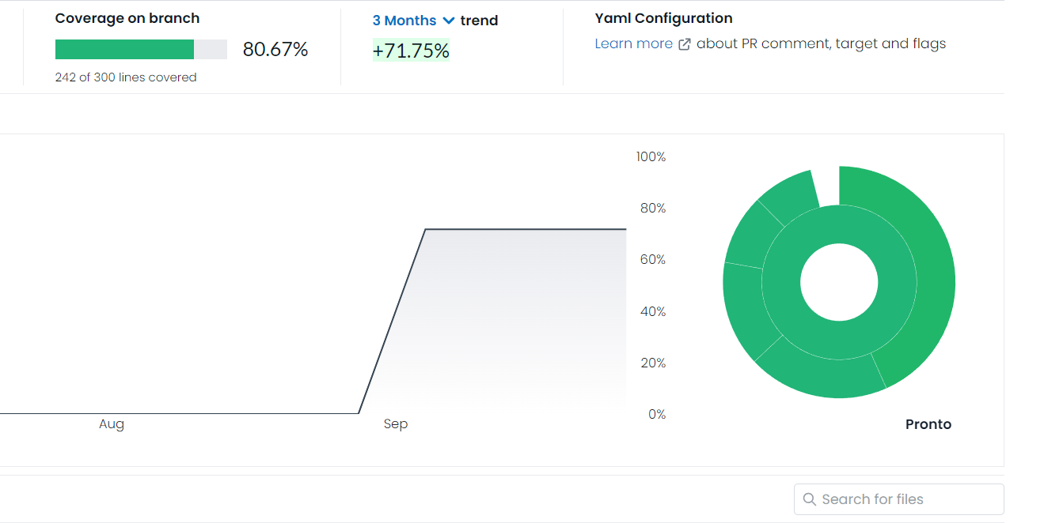
Quality Assurance
Code coverage is currently at 80.67%

Slide 10
Project Management
Agile methodology
Project board on Github
- Github issue system to distribute tasks
- Timelines and Milestones to gauge progress
Resource assessment and Risk management
- Task size and effort estimation per use case
- Contingency plans for unforeseen circumstances
Meetings
- Team meetings every Monday
- Weekly meeting with clients on Wednesdays
- Weekly meeting with Maryam on Fridays
- Project feedback meetings with the other lecturers when necessary

Slide 11
Testing, Automation and Branching
Unit and Integration Testing
Performed in both live and mocked environments
Unit tests performed on the backend and frontend, mobile and web app
Cypress is used for end-to-end/integration testing
GitHub Actions and Pipeline run tests on PR merges
Website automatically deploys on each commit if all tests pass
Automatic security testing through Github actions:
Alerts on outdated versions and security vulnerabilities
Detects common insecure coding techniques such as leaked secrets
Branching strategy - Gitflow Strategy
PRs need three approvals for merge to development branches
Four approvals to the main branch

Slide 12
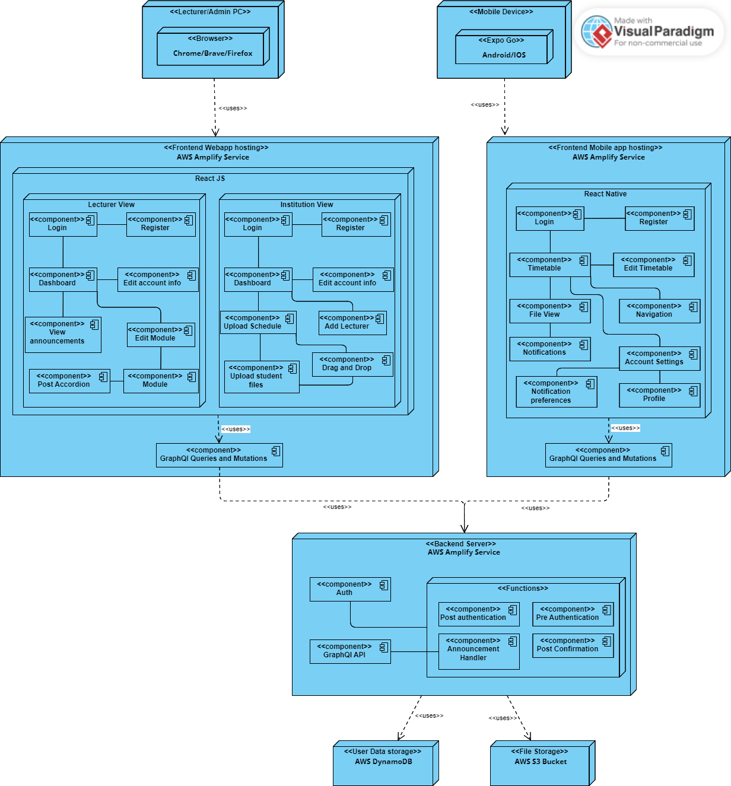
Deployment Model Overview

Slide 13
P
Thanks for listening to us, please feel free to ask any questions!

Slide 14
Links
GitHub Repo:
https://github.com/COS301-SE-2023/Pronto
SRS Document : https://drive.google.com/file/d/1LUEg6gA2hliELFzW1Wq_hfmHdVuQjr5f/view?usp=drive_link
Architectural Requirement: https://drive.google.com/file/d/11U8h3t-zTHTeaVu3NkFpXoySvkSc93KQ/view?usp=sharing
Code Quality Standards:https://drive.google.com/file/d/1TeDSgduA9xSR-UtC5o8woWD2ebrsxQUm/view?usp=drive_link
Code testing Policy: https://drive.google.com/file/d/1hm80mRixI2nZkumoyxx1RWHM4gC5Hc5X/view?usp=drive_link
User Manual: https://drive.google.com/file/d/1S64Oq1E8nKnvYa_C1ijCl5qf9tXQvk40/view?usp=drive_link
Technical Installation Manual: https://drive.google.com/file/d/1Mv5u7FoDHgGCEotsdpyRaIiohG9yk8dN/view?usp=drive_link

